Slide 1

Engineering Case Studies (2)
Professor Bo Liu
James Watt School of Engineering

Slide 2
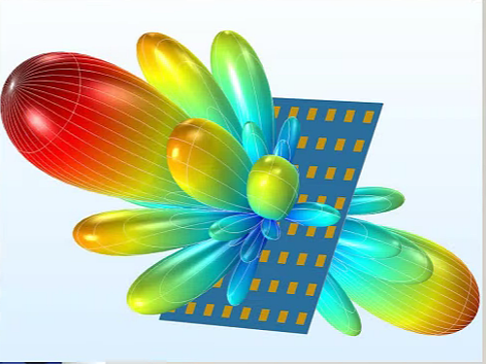
Antenna design— antenna array design
What is the antenna array?
Multiple antennas working at the same frequency are fed and spatially arranged.
Directivity

Slide 3
Antenna design— antenna array design
What is the circular antenna array?
The antennas are arranged in the form of rings.
For circular antenna array design, I=[I₁,... , I_{N}]^{T} is the amplitude of array element feed current, β= [ β₁,…, β_{N}]^{T} is the phase of the array element feed current. [I β]^{T} are the design variables.

Slide 4
Antenna design— antenna array design
Problem description
For circular antenna array, the design requirements include:
The sidelobe (SLL(x)) should not be more than -20 dB.
The directivity (D(x)) should not be less than 10 dB.
The gain (G(x) ) of θ =180° should not be less than – 0.1 dB for achieving the expected maximum radiation direction θ =180°.
G(x) of θ ∈ [80°~120°] should not be more than – 40 dB to nulling control the radiation in θ ∈ [80°~120°] .

Slide 5
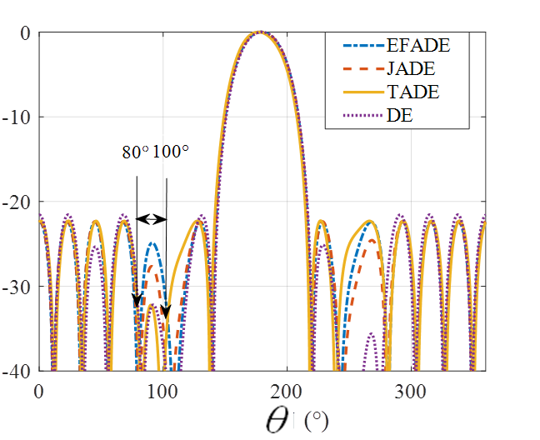
Antenna design— antenna array design
Problem description
However, the designer is not sure if the SLL(x) can meet –20 dB. If not meeting – 20 dB, he/she wants to see how small can it be and then decides the next step.

Slide 6
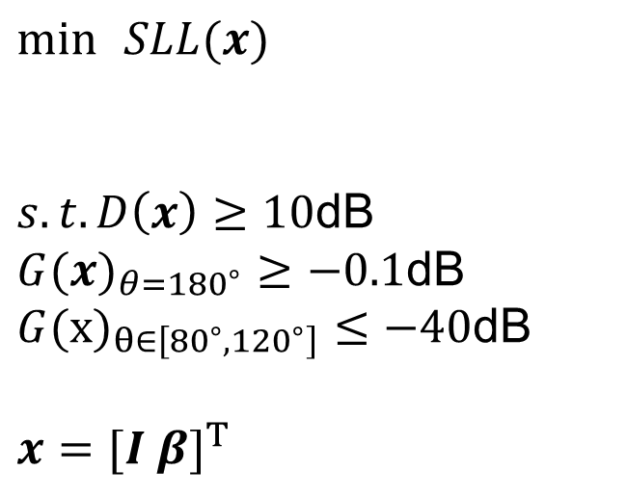
Antenna design— antenna array design
How to formulate the problem into an optimization problem?
Constrained optimization
$$\min{ }SLL(x)$$
$$s.t.D\left(x\right)≥10\text{dB}$$
$$G(x)_{θ=180^{∘}}≥−0.1\text{dB} \\ G(x)_{θ∈\left[80^{∘}, 120^{∘}\right]}≤−40\text{dB}$$
$$x=[I β]^{T}$$
Objective function
Constraints
Design variables

Slide 7
Antenna design— compact antenna design
What is the compact antenna?
Minimize the size.
What is the application of compact antenna?
Biomedical antenna (small size)
Satellite antenna (light weight)

Slide 8
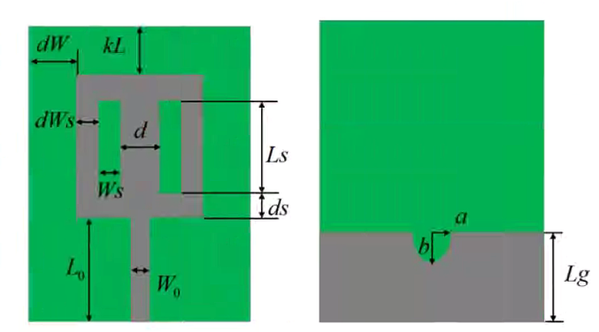
Antenna design— compact antenna design
Problem description
For the patch antenna, the design variables x=[a, b, d, kL, ds, dW, dWs, L0, Lg, Ls, Ws]. There are 2 design requirements.
The first objective is the magnitude of maximum return loss (|S₁₁(x)|) smaller than -9 dB in the 4 GHz to 10 GHz operating band.
The second objective is the size of the antenna smaller than 400 mm².
Even when meeting the requirements, the designer hopes to further optimize them.

Slide 9
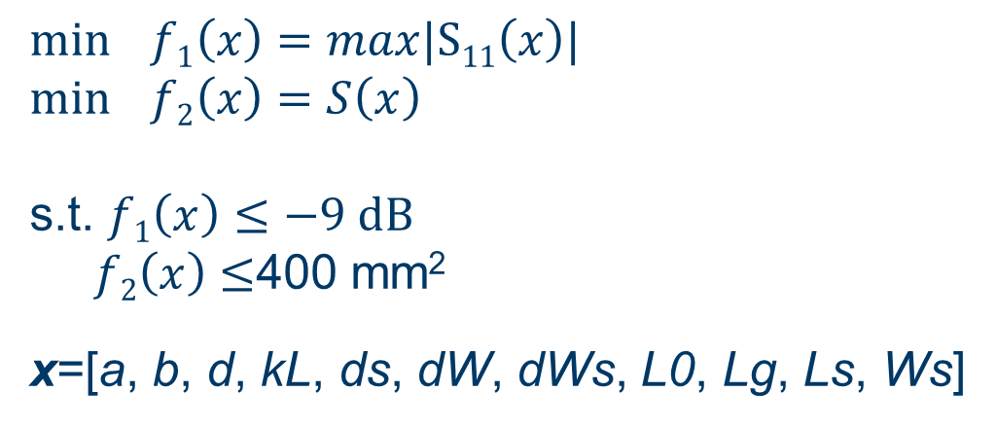
Antenna design— compact antenna design
How to formulate the problem to an optimization problem?
Multi-objective optimization
$$\min{f1\left(x\right)=max|S11\left(x\right)|}$$
$$\min{f2\left(x\right)=S\left(x\right)}$$
s.t. $f1\left(x\right)≤−9 dB$
$f2\left(x\right)≤$400 mm²
x=[a, b, d, kL, ds, dW, dWs, L0, Lg, Ls, Ws]
Objective functions
Inequality constraints
Design variables

Slide 10




Thanks!
#UofGWorldChangers
@UofGlasgow

